Slide 1

多媒体系统导论 Fundamentals of Multimedia System
授课教师：张小燕
xyzhang15@szu.edu.cn
2021年春季课程

Slide 2
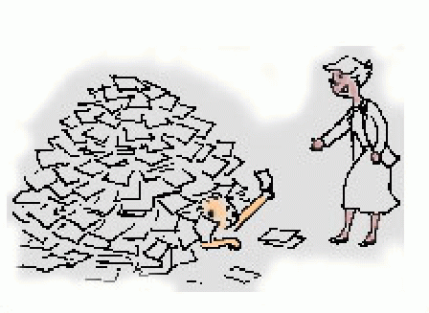
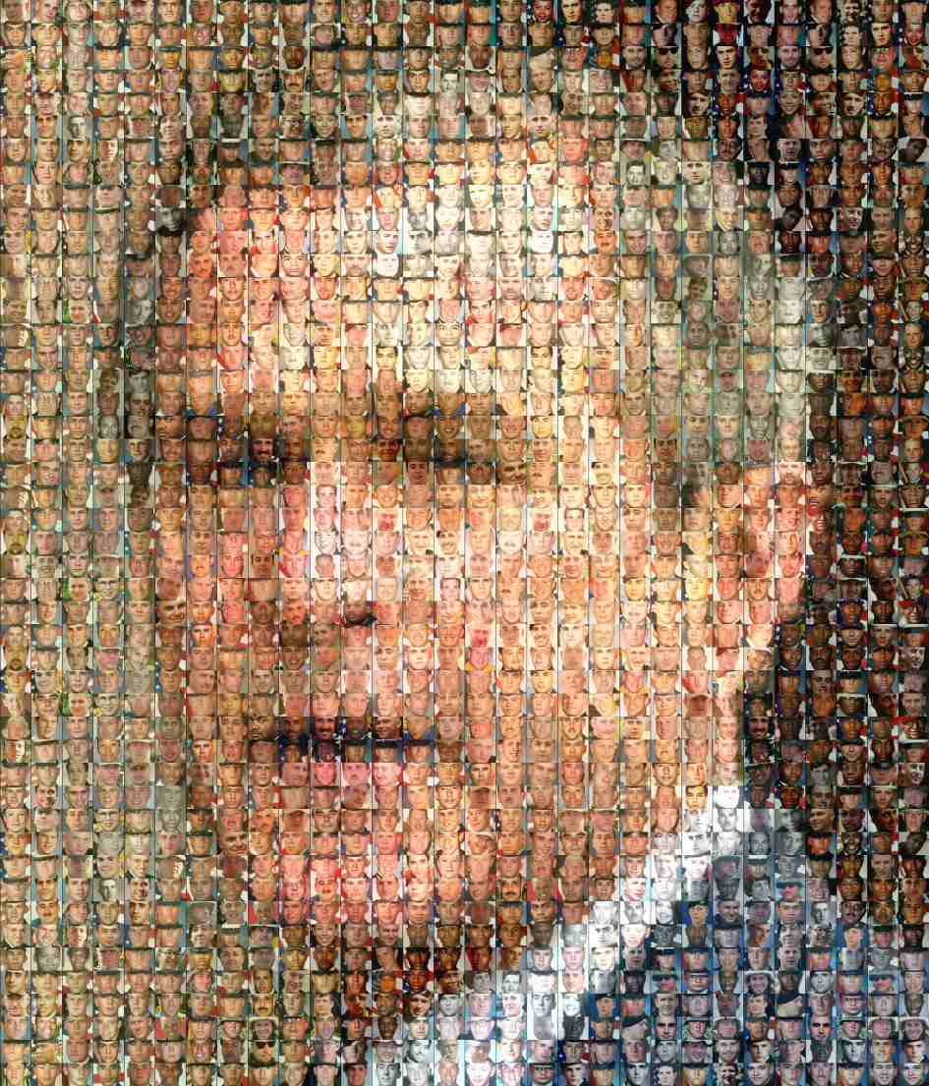
Background
Necessity of retrieval
Information is of no use, unless you can actually access it.
Why do we need image retrieval?
“A Picture is worth thousand words”
Not everything can be described in text
Not everything is described in text
[from the TREC homepage: trec.nist.gov]
Notes:
在信息爆炸的大数据时代，检索技术尤为重要。对于普通用户而言，如果他不能从海量的数据中找到他感兴趣的内容，那这个大数据是无用的。检索技术是解决这个问题的关键。
检索可以采用不同的媒体形式，比如文本检索，图像检索。大家平时比较多的可能是百度、微软、或谷歌的文本检索工具。图像检索也是一种非常重要的检索。
首先，图像表达的信息是非常丰富的，有道是“一图胜千言”。而且，我们平时也经常会碰到一些不可名状的东西，图像是一种很好的信息表达方式。

Slide 3

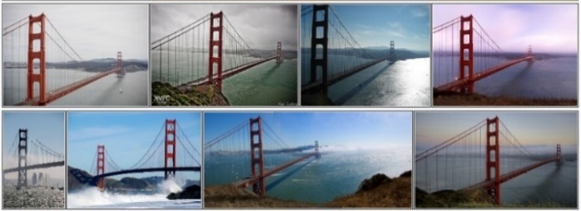
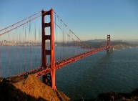






Background
Content based image retrieval
Database
Database size：>10⁶~10⁹
Query response：realtime
Query
Search
……
Retrieval Results
Potential applications of content based image retrieval
图像溯源检索
商品图像检索
监控目标检索
纹身图像检索
……
版权保护
网络购物
安防监控
刑侦分析
Notes:
这次报告，我们主要关注的是基于内容的图像检索，也就是以图搜图。换句话说，

Slide 4
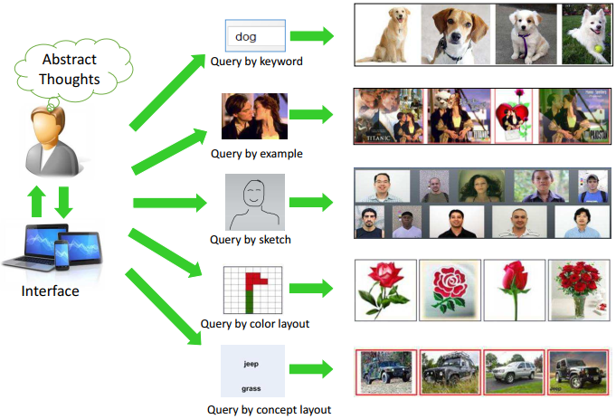
Image Retrieval
Illustration of different query schemes with the corresponding retrieval results

Slide 5
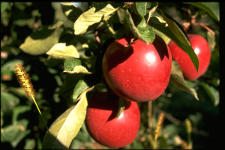
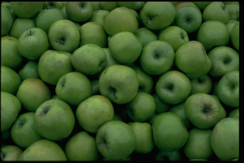
Why is Image Retrieval Hard ?
A picture is worth a thousand words
The meaning of an image is highly individual and subjective

Slide 6
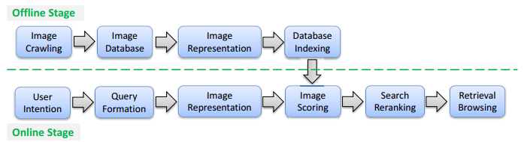
Framework
The general framework of content-based image retrieval

Slide 7
Problems with Image Retrieval
数据库规模大，包含图像数量多
多
好
省
检索精度高
数据库索引内存开销小
快
可有效度量图像
相关性的特征表达
高效的索引方法
查询响应快
高效的查询策略

Slide 8
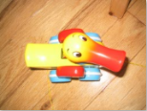
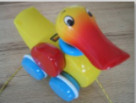

Basic Problems
图像检索基本问题之一：如何计算图像间的内容相关性？
图像表征：非结构化图像数据的结构化表达
SIFT + BoW/VLAD/FV
Activations of the intermediate layers of CNN model
相似性度量：基于图像表征的相关性计算
d₁
d₁ < d₂
d₂
…
图像
表征空间
Notes:
基于内容的图像检索基本问题是如何计算图像间的内容相似性，两个方面内容：首先是图像表征，即如何把非结构化的图像数据进行结构化表达，从而方便图像间的内容比较。第二是图像相似性度量，即如何基于图像表征来准确计算图像间的内容相关性。
VLAD是vector of locally aggregated descriptors的简称，是由Jegou et al.在2010年提出，其核心思想是aggregated(积聚)，主要应用于图像检索领域，，FV-Fisher Vector

Slide 9
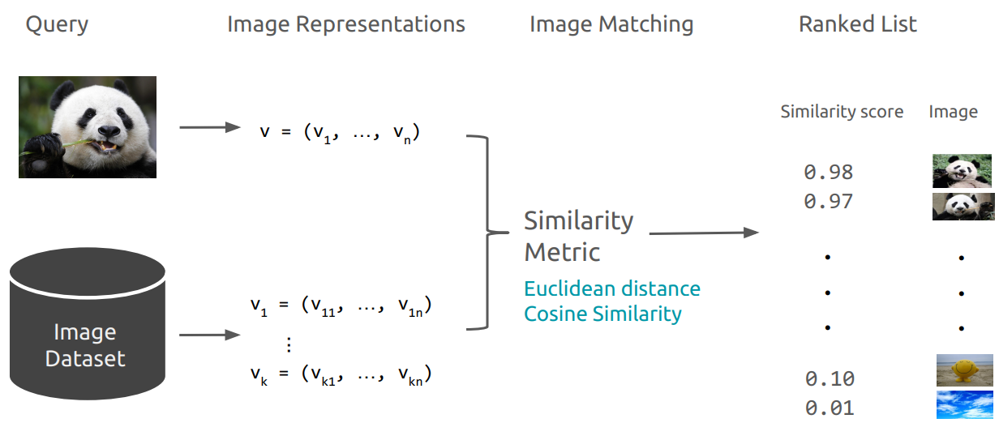
Based on Hand-Crafted Features

Slide 10
Global Features
Color (histograms, wavelets)
Texture (灰度共生矩阵, Gabor filters, LBP（局部二值模式）)
Shape (Boundary Matching)
Objects and their Relationships

Slide 11
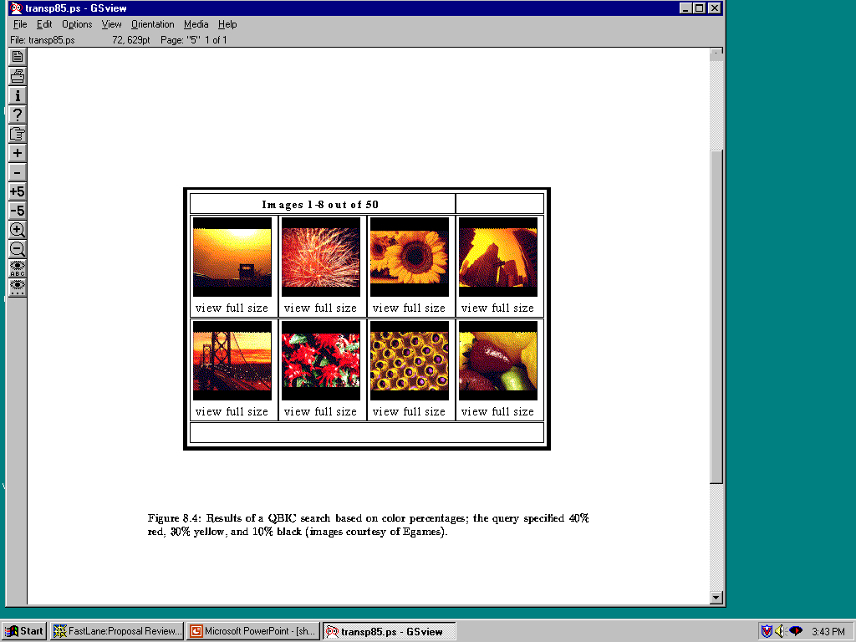
Color Histograms

Slide 12
Histogram Similarity
The QBIC color histogram distance is:
dhist(I,Q) = (h(I) - h(Q)) A (h(I) - h(Q))
T
h(I) is a K-bin histogram of a database image
h(Q) is a K-bin histogram of the query image
A is a K x K similarity matrix
Notes:
不受图像旋转和平移变化的影响，归一化可不受图像尺度变化的影响
在图像识别中辨别能力不高，颜色容易受光照的影响

Slide 13
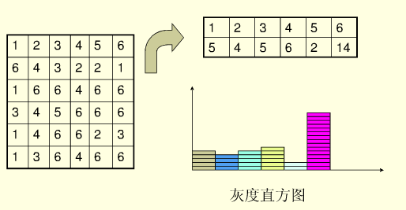
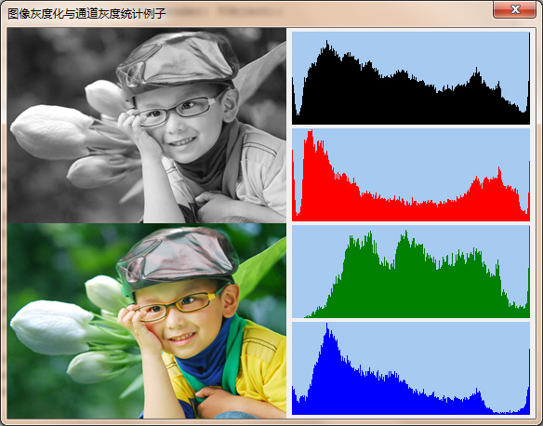
颜色直方图
一个灰度级在范围[0，L-1]的数字图像的直方图是一个离散函数
p(rk)= nk /n
n 是图像的像素总数
nk是图像中灰度级为rk的像素个数
rk 是第k个灰度级，k = 0,1,2,…,L-1
13

Slide 14
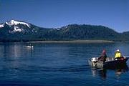
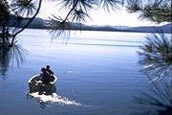
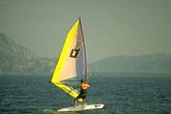
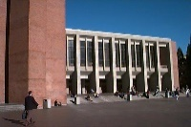
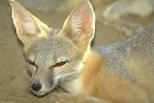
Object-based
Query Image
Retrieved Images
User
boat
Image Database
…
Animals
Buildings
Office Buildings
Houses
Transportation
Boats
Vehicles
…
Object-oriented Feature Extraction
Images
Categories

Slide 15
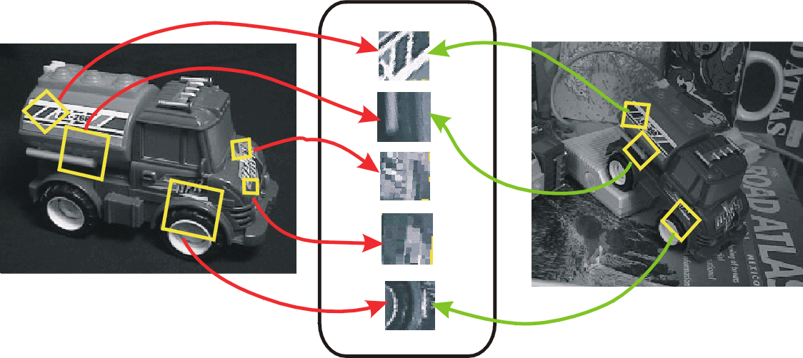
Local Features
Find features that are invariant to transformations
geometric invariance: translation, rotation, scale
photometric invariance: brightness, exposure, …

Slide 16
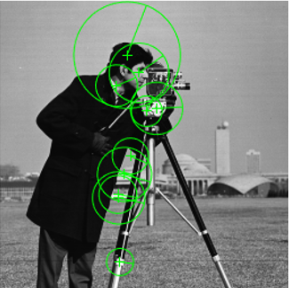


Local Features
SIFT
LBP
SURF
BRISK
And so on
Local feature extraction in Matlab
https://www.mathworks.com/help/vision/ug/local-feature-detection-and-extraction.html

Slide 17
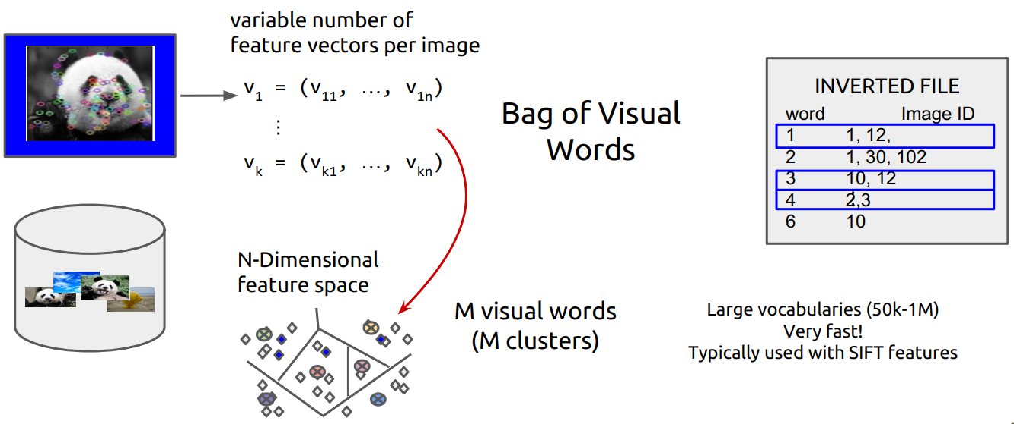
Local Features

Slide 18
Some important terms
Global Features: e.g. 颜色直方图
Local Features: e.g. sift
BoW^{[1]}: Bag of (Visual) Words
VLAD^{[2]}: Vector of Aggregate Locally Descriptor
FV^{[3]}: Fisher Vector
Invert Index
[1] J. Sivic and A. Zisserman, “Video Google: A text retrieval approach to object matching in videos,” in Proc. Int. Conf. Comput. Vis., 2003, Art. no. 1470.
[2] H. Jegou, M. Douze, C. Schmid, and P. Perez, “Aggregating local descriptors into a compact image representation,” in Proc. IEEE Conf. Comput. Vis. Pattern Recog., 2010, pp. 3304–3311.
[3] F. Perronnin, J. S anchez, and T. Mensink, “Improving the Fisher kernel for large-scale image classification,” in Proc. Eur. Conf. Comput. Vis., 2010, pp. 143–156.

Slide 19
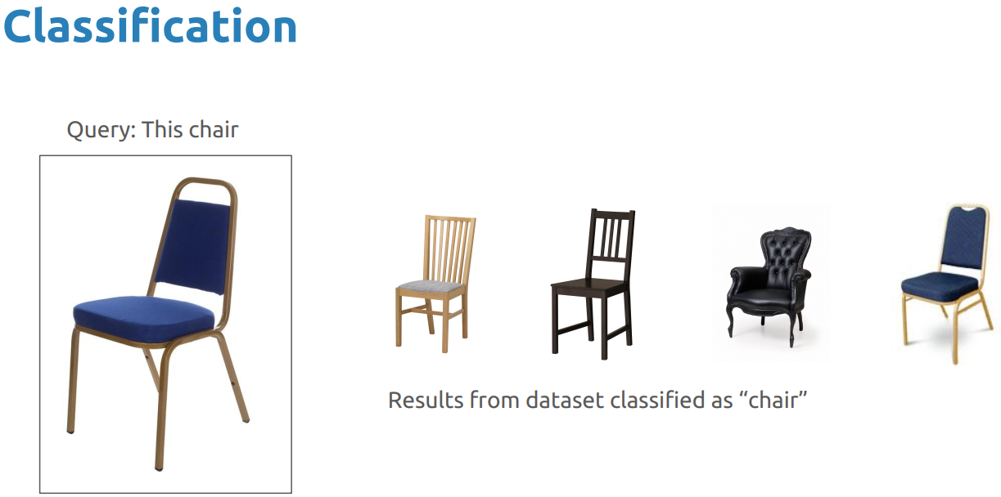
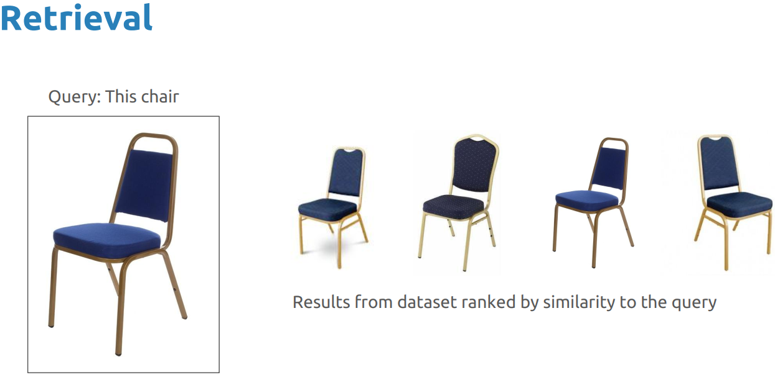
Image Retrieval & Image Classification

Slide 20
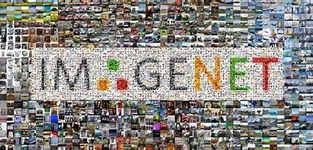



Based on Deep Learning
深度学习在计算机视觉领域取得巨大成功
ImageNet Grand Challenge
深度学习：时势造英雄
大规模图像视频数据
强大的计算能力：GPU/TPU
60亿张图片，2011年
2500亿张图片，2013年
Notes:
通过在imagenet grand challenge上不断刷新记录，深度学习在计算机视觉领域大放异彩。
深度学习的很多技术或思想，比如BP算法、卷积层、跨层连接等，在二三十年前都有出现过。它之所以在今天能取得这么大的成果，从某种意义上讲，是一种时势造英雄：我们有大规模的含标注的训练数据，有非常强大的GPU/TPU计算资源。

Slide 21
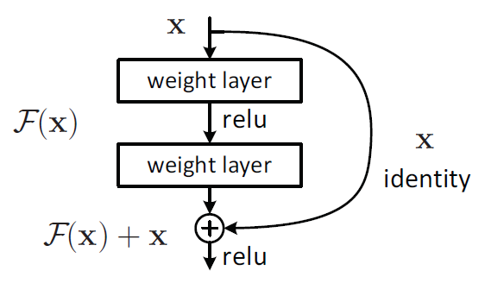
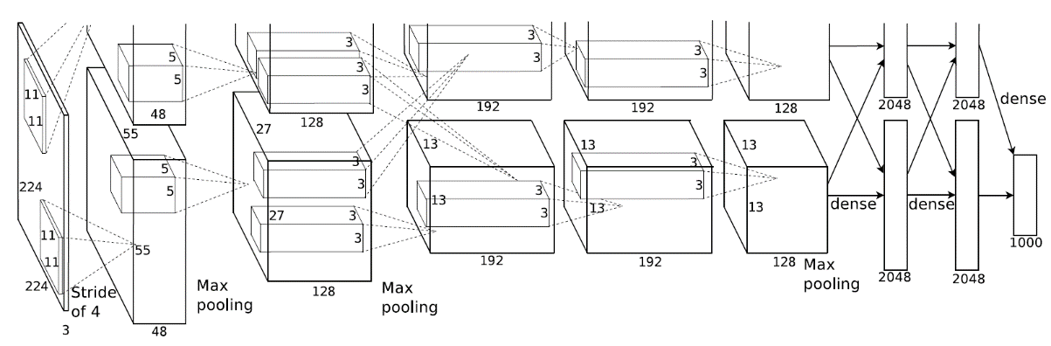
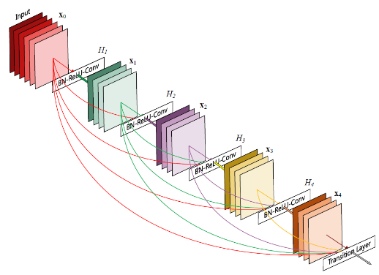
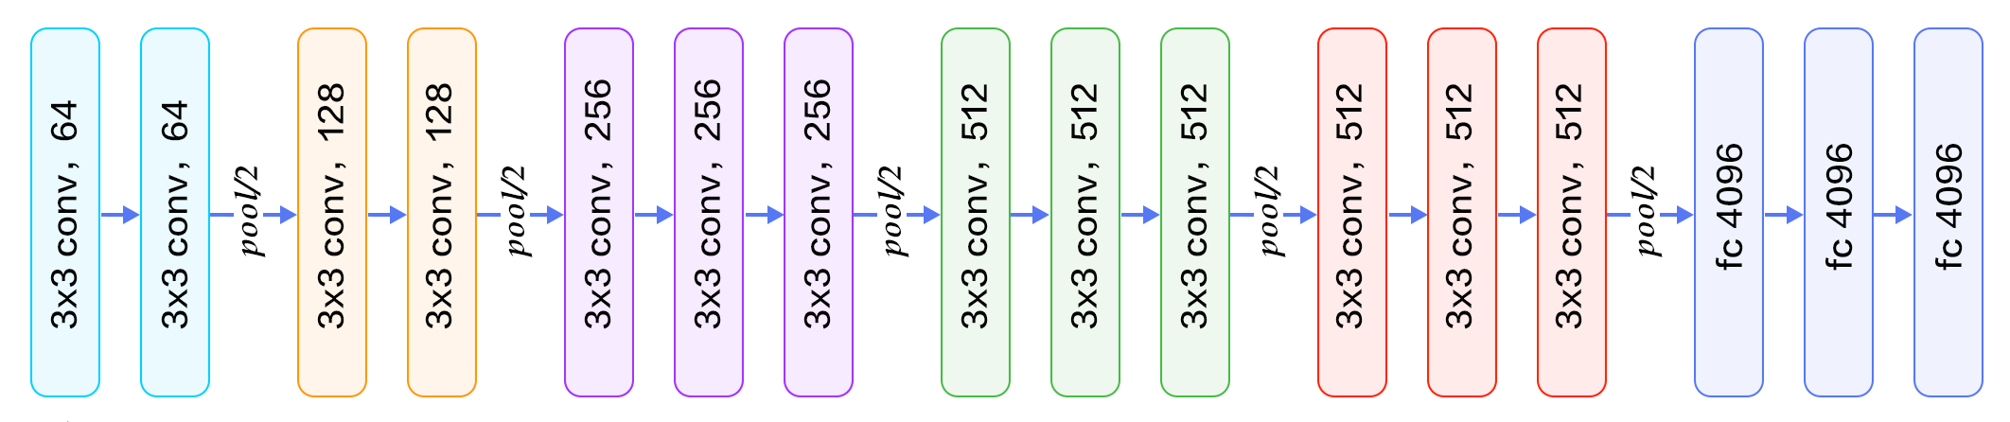

研究背景：深度学习
面向图像分类的深度学习模型
ResNet, 2015
AlexNet, 2012
DenseNet, 2017
VGGNet, 2014
GoogLeNet, 2014
Notes:
除了图像分类，这些网络模型也被成功地应用于其他任务，比如目标检测、视频动作识别。

Slide 22
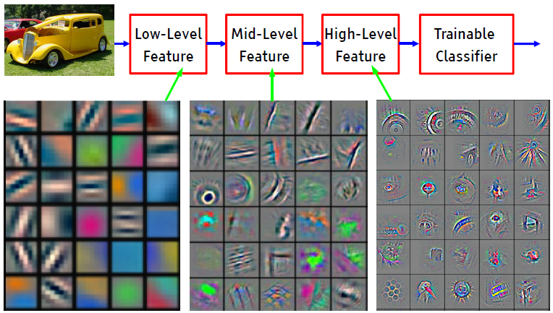
研究背景：深度学习
深度学习本质：层次化的表征学习
High-Level
Concept
[Courtesy of Yann Le Cun]
Feature visualization of convolutional net trained on ImageNet from [Zeiler & Fergus 2013]

Slide 23
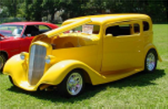

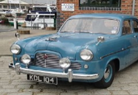
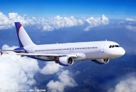
研究背景：深度学习
图像分类 vs. 图像检索
Low-Level
Feature
Mid-Level
Feature
High-Level
Feature
Trainable
Classifier
High-Level
Concept
Feature Extraction
Classification
已知
未定义
d₁
d₂
图像类别
d₁ < d₂
图像分类：特征空间划分
图像检索：相关度度量

Slide 24
如何将深度学习用于图像检索？
关键：大规模标注的训练数据
Low-Level
Feature
Mid-Level
Feature
High-Level
Feature
Trainable
Classifier
High-Level
Concept
Feature Extraction
Classification
Option 1:
利用图像分类任务进行预训练
基于上述网络提取特征，用于检索
Option 2:
面向检索任务，设计监督信息
fine-tune预训练好的CNN模型

Slide 25
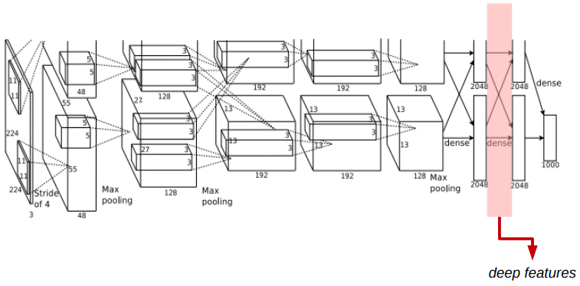
https://www.mathworks.com/help/deeplearning/ug/deep-learning-in-matlab.html
https://www.mathworks.com/help/deeplearning/ref/vgg16.html
https://www.mathworks.com/help/deeplearning/ug/extract-image-features-using-pretrained-network.html

Slide 26
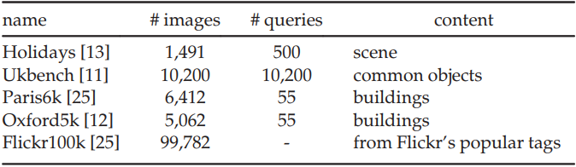
Dataset
Holidays: http://lear.inrialpes.fr/people/jegou/data.php
Ukbench: http://www.vis.uky.edu/∼stewe/ukbench/ Paris6k: http://www.robots.ox.ac.uk/∼vgg/data/parisbuildings/ Oxford5k: http://www.robots.ox.ac.uk/∼vgg/data/oxbuildings/ Flickr100k: http://www.flickr.com/

Slide 27
Dataset
UKBench dataset It contains 10,200 images from 2,550 categories9. In each category, there are four images taken on the same scene or object from different views or illumination conditions. All the 10,200 images are taken as query and their retrieval performances are averaged.
Holidays dataset There are 1,491 images from 500 groups in the Holidays dataset10. Images in each group are taken on a scene or an object with various viewpoints. The first image in each group is selected as query for evaluation.
Oxford Building dataset (Oxford-5K) The Oxford Buildings Dataset consists of 5062 images collected from Flickr by searching for particular Oxford landmarks. The collection has been manually annotated to generate a comprehensive ground truth for 11 different landmarks, each represented by 5 possible queries. This gives a set of 55 queries over which an object retrieval system can be evaluated. Some junk images are mixed in it as distractor.
Paris dataset In the Paris dataset13, there are 6,412 images, which are collected from Flickr by searching for 12 text queries of particular Paris landmarks. For this dataset, 500 query images are used for evaluation

